Slide 1
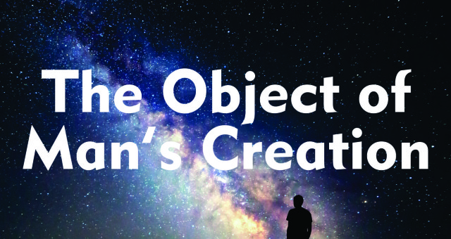

Slide 2
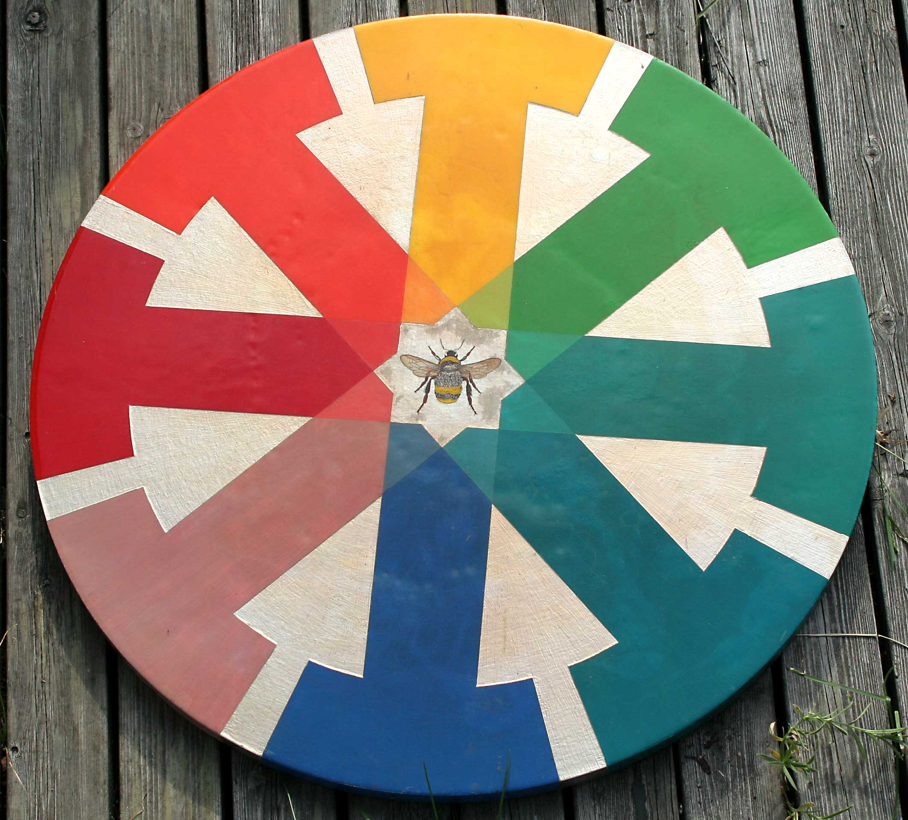
Or
Why am I here?

Slide 3
From a spiritual perspective your purpose, your life goal, the reason you are here, is found in:
The self-validating experience of yourself as
One, invulnerable, eternal, unchanging Self.

Slide 4
This “truth” is found in the teachings of many spiritual masters.
To know the truth of one's Self as the sole reality, and to merge and become one with it, is the only true Realization.
- Sri Ramana Maharshi.

Slide 5
I in them, and thou in me, that they may be made perfect in one; and the world may know that thou has sent me, and hast loved them, as thou hast loved me.
- Jesus Christ ( John 17:23 ).

Slide 6
The union of self with Self produces a state of indescribable happiness.

Slide 7
The body has been projected by the mind, which itself originates in Spirit.
If the wrong identification ceases, there will be peace and permanent, indescribable bliss.
- Sri Ramana Maharshi.

Slide 8


Slide 9
“A Course in Miracles”, first published in 1975, is a spiritual masterwork that describes itself as a course in mind training. It’s one goal: the delivery of peace.

Slide 10
The Course teaches that God, the First Cause, has no opposite.
It sums up its teachings in three sentences.
Nothing real can be threatened.
Nothing unreal exists.
Herein lies the peace of God.

Slide 11
The Bhagavad-Gita, estimated to be 5,000 years old, mirrors the Course’s Introduction.
The unreal has no being;
the real never ceases to be.
The final truth about them both has thus been perceived by the seers of ultimate Reality. 2:16

Slide 12
God, the Creator, the First Cause, expresses the joy of formless Being by expanding infinitely into infinity creating Gods, which is what you are.
Is it not written in your law, I said, Ye are Gods? - Jesus ( John 10:34)

Slide 13
Then the question arises:
Why do I, a God, created out of infinite Love, suffer pain, guilt and the belief in sin?

Slide 14
The answer may surprise you.
Because you choose to.

Slide 15
This world, with all its horrors and pleasures, and the body you “live in” to experience it, are just the impossible, imagined real.
By you.

Slide 16
All the world's a stage,
And all the men and women merely players;
They have their exits and their entrances,
And one man in his time plays many parts,
- William Shakespeare, “As you like it”.

Slide 17
“As you like it” is the perfect title for the play and the perfect segue for the Course’s description of our part in the dream that we experience as the world.

Slide 18
⁸¹ How willing are you to escape effects of all the dreams the world has ever had? Is it your wish to let no dream appear to be the cause of what it is you do? Then let us merely look upon the dream's beginning, for the part you see is but the second part, whose cause lies in the first. No one asleep and dreaming in the world remembers his attack upon himself. No one believes there really was a time when he knew nothing of a body and could never have conceived this world as real. He would have seen at once that these ideas are one illusion, too ridiculous for anything but to be laughed away. How serious they now appear to be! And no one can remember when they would have met with laughter and with disbelief.

Slide 19
⁸² We can remember this if we but look directly at their cause. And we will see the grounds for laughter, not a cause for fear. Let us return the dream he gave away unto the dreamer who perceives the dream as separate from himself and done to him. Into eternity, where all is one, there crept a tiny mad idea at which the Son of God remembered not to laugh. In his forgetting did the thought become a serious idea and possible of both accomplishment and real effects. Together, we can laugh them both away and understand that time cannot intrude upon eternity. It is a joke to think that time can come to circumvent eternity, which means there is no time.

Slide 20
What then of guilt and sin?
The Course teaches that the two don’t exist and are a construct of the ego, the part of our mind that believes there is another beside our self and which believes we are weak, vulnerable and fearful; subject to time and space; and, finally, to death.

Slide 21
The Course consists of a theoretical Text and a Workbook of daily lessons (to be completed in no less than a year) to train the mind to awaken to its full Self and the happy realization we are powerful and invulnerable and that our essence is freedom, love, peace and joy and that these four attributes are synonymous.

Slide 23
“Journey Beyond Words” and “The Other Voice” are two texts that support the Course Text and Workbook. They make startling but profound connections.

Slide 24
For example, “The Other Voice”, which supports the Course Text, in the Chapter Guilt I, equates guilt…
with time.

Slide 25
The Holy Spirit, the idea of your Oneness,
Is the bridge between the split parts of your mind, and was placed there by God (and therefore, by You). Were it not so you could have imagined yourself separate,
And remained that way forever.

Slide 26
“Forever” seems to speak of time. And yet the concept of forever abolishes time. The other concept that abolishes time is NOW. It is your guilt, it is your belief in, and your desire to experience, separation that has created time in the first place. For, as we have said, time is that which allows you to take part of the knowledge of what you are and seem to throw it away.

Slide 27
What you really do is project it outside your mind so that you are no longer aware of it. And in the absence of the awareness of who you are, you believe yourself to be separate, and isolated and alone.
And that is the creator of your time.
And that is the creator of your guilt.

Slide 28
So in a very real sense, your belief in time and your guilt are one and the same. Indeed, as long as you choose to believe that your yesterdays, the moments of your past, have brought you to this moment in time, and as long as you believe that this moment in time somehow can, and does, create the next moment, you are but cherishing your belief in separation, and your own guilt.

Slide 29
For you could not, hear me well, believe in your time, or even experience your time, if you were aware of your own wholeness.
For when you are whole, everything merely IS. You have everything. You are everything. And you automatically extend that self-same everything outward from yourself to all of Creation. That is healing. And that causes you to be healed.

Slide 30
The wholeness that you are in Reality and that leads to healing is beautifully described in Chapter 21 of A Course in Miracles in the first section,
“The Forgotten Song”.

Slide 31
⁰ Beyond the body, beyond the sun and stars, past everything you see and yet somehow familiar, is an arc of golden light that stretches as you look into a great and shining circle. And all the circle fills with light before your eyes. The edges of the circle disappear, and what is in it is no longer contained at all. The light expands and covers everything, extending to infinity, forever shining and with no break or limit anywhere. Within it everything is joined in perfect continuity. Nor is it possible to imagine that anything could be outside, for there is nowhere that this light is not.

Slide 32
⁰ ¹¹ This is the vision of the Son of God, whom you know well. Here is the sight of him who knows his Father. Here is the memory of what you are—a part of this, with all of it within and joined to all as surely as all is joined in you. Accept the vision which can show you this and not the body. You know the ancient song and know it well. Nothing will ever be as dear to you as is this ancient hymn of love the Son of God sings to his Father still.

Slide 33
⁰ ² And now the blind can see, for that same song they sing in honor of their Creator gives praise to them as well. The blindness which they made will not withstand the memory of this song. And they will look upon the vision of the Son of God, remembering who he is they sing of. What is a miracle but this remembering? And who is there in whom this memory lies not? The light in one awakens it in all. And when you see it in each other, you are remembering for everyone.

Slide 34
